Slide 1

Fundamental Concepts in Machine Learning Model Evaluation (2)
Professor Bo Liu
James Watt School of Engineering

Slide 2



Bias-variance trade-off
No escaping the relationship between bias and variance:
  Increasing the bias will decrease the variance.
  Increasing the variance will decrease the bias.
A good balance between bias and variance such that it minimizes the total error.
$$Total error$$
Error
Optimal balance
Optimal balance never overfit or underfit the model.
$$Variance$$
$$Bias^{2}$$
Algorithm complexity

Slide 3
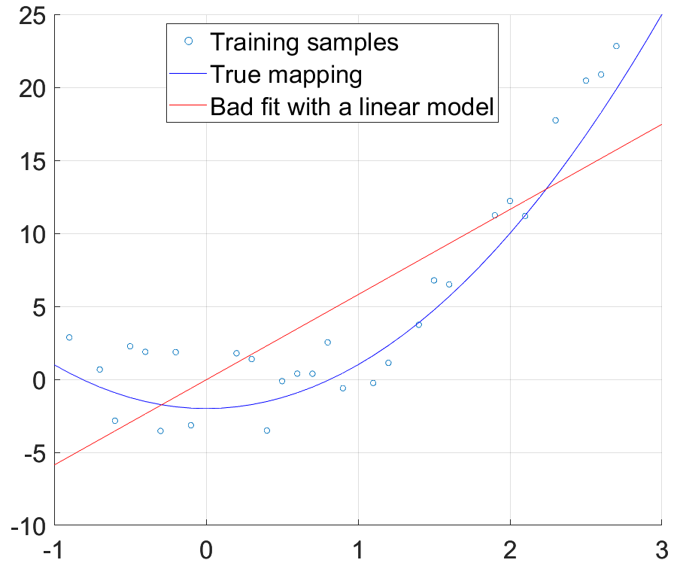
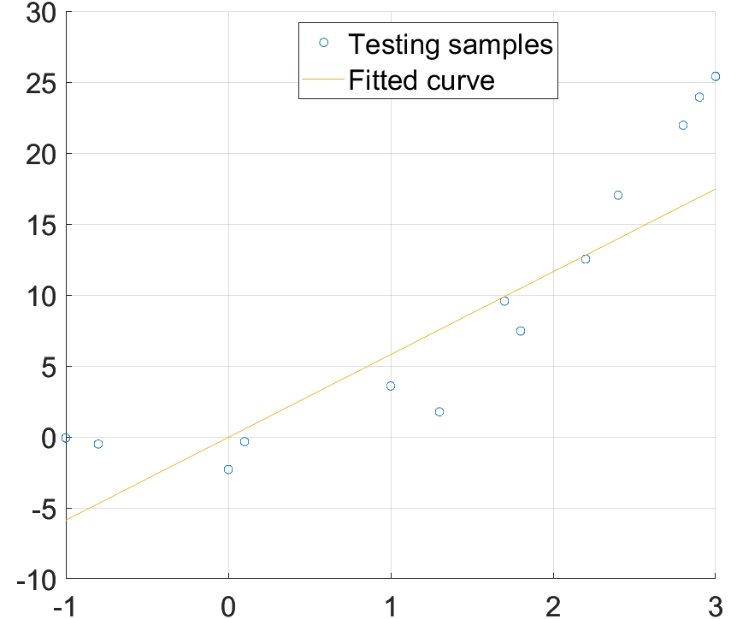
Bias-variance trade-off: linear regression
High bias fitting
Training set
Test set
A high bias model has high prediction errors on both training set and test set.

Slide 4
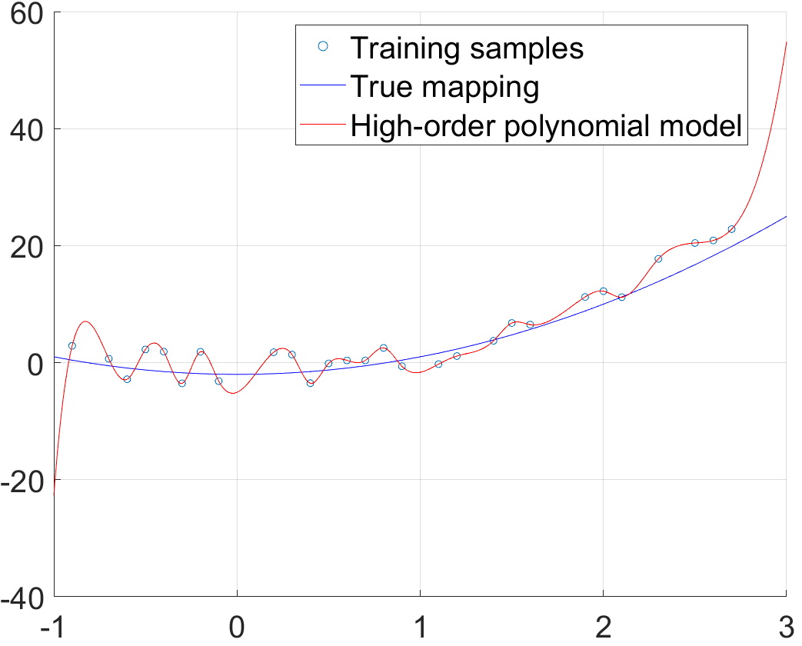
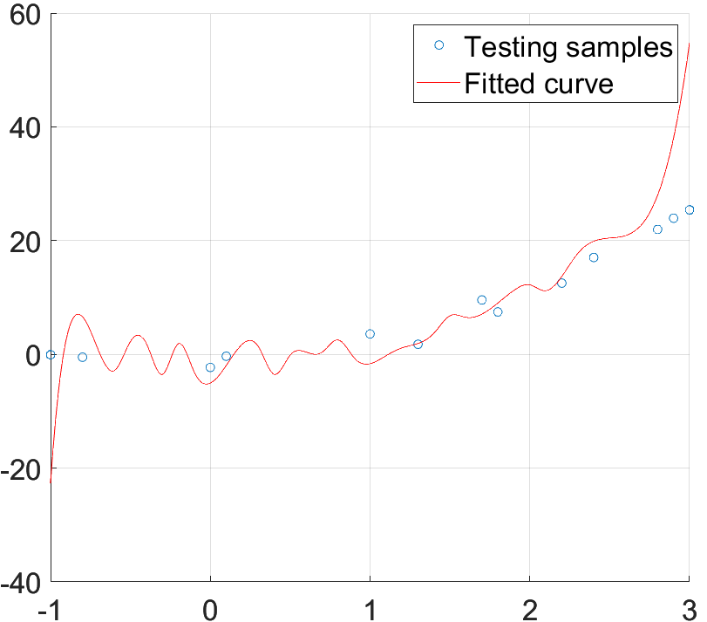
Bias-variance trade-off: linear regression
High variance fitting
Training set
Test set
A high variance model has very low prediction error on the training set.
But has high error on test set.

Slide 5
Generalization
Generalization refers to how well the knowledge learned by an ML model apply to new data not seen by the model.
Good ML model generalizes well from the training data to any other data in the problem domain.
Regression
Classification

Slide 6
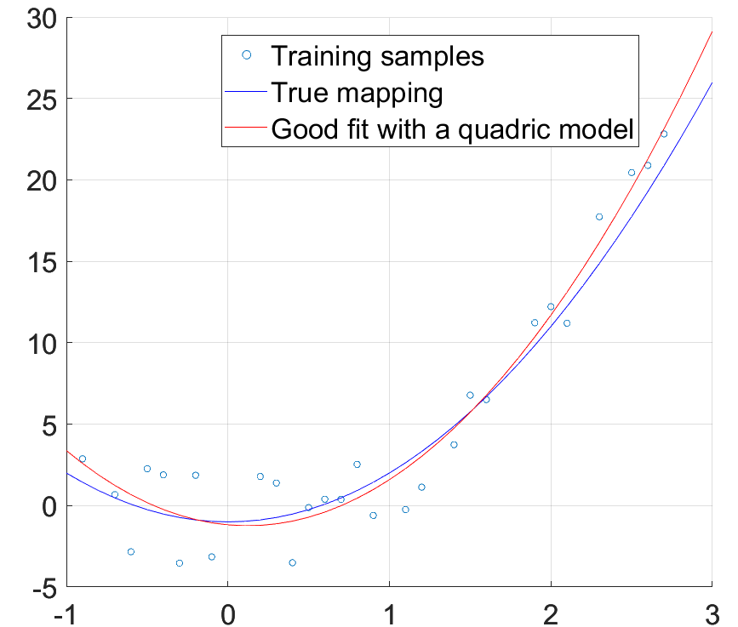
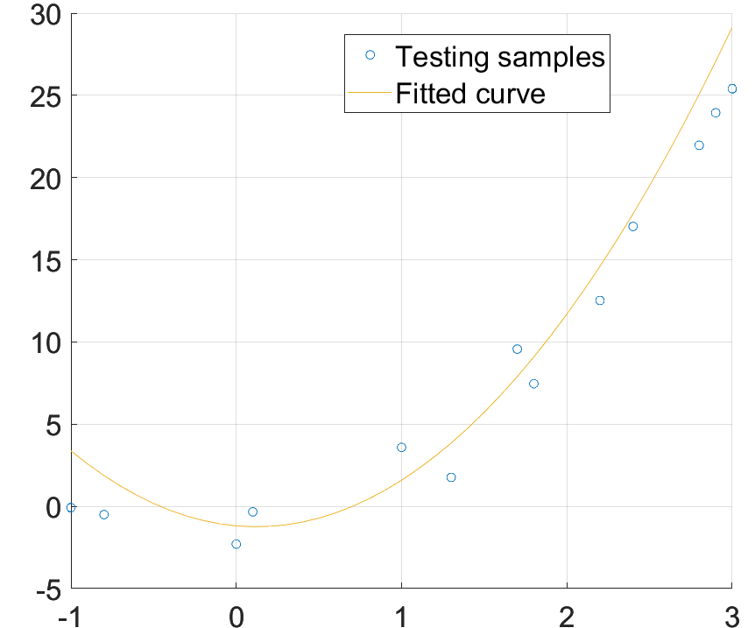
Bias-variance trade-off: linear regression
Good fitting
Training set
Test set
A good fitting model has low prediction errors on both training set and test set.

Slide 7




Thanks!
#UofGWorldChangers
@UofGlasgow

